Slide 1


K.RAMAKRISHNAN COLLEGE OF TECHNOLOGY
(AUTONOMOUS), TRICHY.
SUPERMARKET BILLING SYSTEM
PRESENTED BY
HARITHA K
2303811710422057
SUPERVISOR
Mr. M. Saravanan, M.E.,
AP/CSE.

Slide 2
PRESENTATION OVERVIEW
Objective
Project Introduction
Problem Statement
Methodologies (Programming concepts relevant to problem statement)
Architecture of the proposed system
List of Modules
Merits
Results and Discussion
Queries

Slide 3
OBJECTIVE
The objective of the supermarket billing system is to develop a comprehensive solution capable of efficiently handling various types of transactions while streamlining the management of sales, inventory, and customer data. The system should support functionalities such as product scanning, generating detailed invoices, and processing payments through multiple modes, including cash, card, and digital wallets. Additionally, it should maintain real-time inventory updates, provide detailed sales reports, and ensure the seamless integration of loyalty programs or discounts to enhance customer satisfaction. By automating these processes, the system aims to minimize errors, reduce checkout times, and improve overall operational efficiency in a supermarket environment.

Slide 4
PROJECT INTRODUCTION
A supermarket billing system is an essential tool designed to efficiently handle various types of transactions and streamline the overall management of supermarket operations. This system automates the billing process, ensuring accuracy and speed while minimizing human error. It manages diverse transactions, including sales, returns, discounts, and payment methods such as cash, card, or digital wallets. Additionally, the system can maintain comprehensive records of inventory, generate detailed sales reports, and track customer preferences, contributing to better decision-making. By integrating advanced features like barcode scanning and real-time data updates, a supermarket billing system enhances customer experience and optimizes business efficiency.

Slide 5
PROBLEM STATEMENT
The traditional manual billing process in supermarkets is prone to inefficiencies, including errors in calculations, longer checkout times, and difficulty in managing inventory and transactions effectively. These challenges often lead to customer dissatisfaction and hinder operational efficiency. Additionally, tracking sales data, applying discounts, and managing returns manually can be time-consuming and prone to inaccuracies. With the increasing volume of customers and diverse payment methods, supermarkets require a streamlined solution to handle transactions efficiently, reduce errors, and improve the overall shopping experience. A well-designed supermarket billing system addresses these issues by automating processes, ensuring accuracy, and enhancing both customer satisfaction and business operations.

Slide 6
METHODOLOGIES
1.Object-Oriented Programming (OOP):
The application is structured using OOP principles, encapsulating the GUI and functionality within the `PasswordGeneratorGUI` class.
2.Graphical User Interface (GUI) Design:
Java Swing is employed to design an interactive and user-friendly GUI, integrating components like JLabel, JTextField, JButton, and JCheckBox.

Slide 7
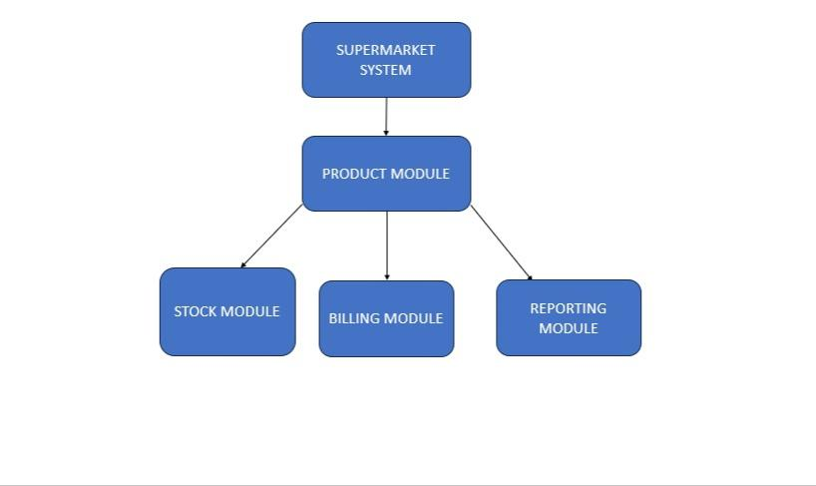
ARCHITECTURE OF THE PROPOSED SYSTEM

Slide 8
LIST OF MODULES
1.Product Management
3. Billing System
4. Report Generation
2. Transaction Handling

Slide 9
MODULE DESCRIPTON
1.Product Management
This module allows for the addition, updating, and removal of products in the system, ensuring that product information such as ID, name, price, and stock levels are accurately maintained.
2. Transaction Handling
Facilitates user interaction to select products and quantities while validating inputs. It handles the calculation of totals, taxes, and discounts, ensuring that the correct amount is charged for each transaction. This module tracks the items being purchased, their quantities, and applies any promotions or loyalty discounts.

Slide 10
MODULE DESCRIPTON
3. Billing System
It calculates the total price of the products purchased, including taxes, discounts, and loyalty rewards, based on the items added to the cart. The system generates a detailed bill showing the product names, quantities, individual prices, and the total amount due.
4. Report Generation
Summarizes transaction details and generates insights into stock levels and sales trends. The module tracks key performance metrics such as total sales, revenue, discounts applied, and payment methods used, helping managers evaluate sales trends and monitor the effectiveness of promotions.

Slide 11
MERITS
1.Improved Efficiency:
Automates billing processes, significantly reducing checkout times and improving customer service.
2. Accuracy:
Minimizes human errors in transactions, calculations, and inventory management, ensuring precise records and reports.
3. Enhanced Customer Experience:
Provides faster service, supports multiple payment methods, and ensures smooth checkout, leading to higher customer satisfaction.
4. Inventory Management:
Tracks stock levels in real-time, helping supermarkets avoid overstocking or stockouts and optimize inventory control.

Slide 12
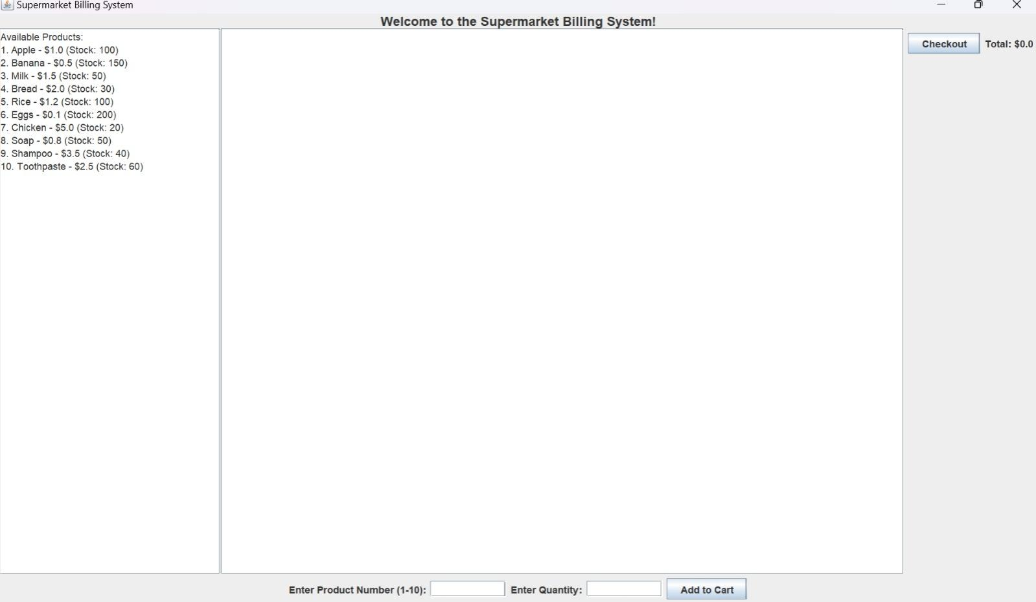
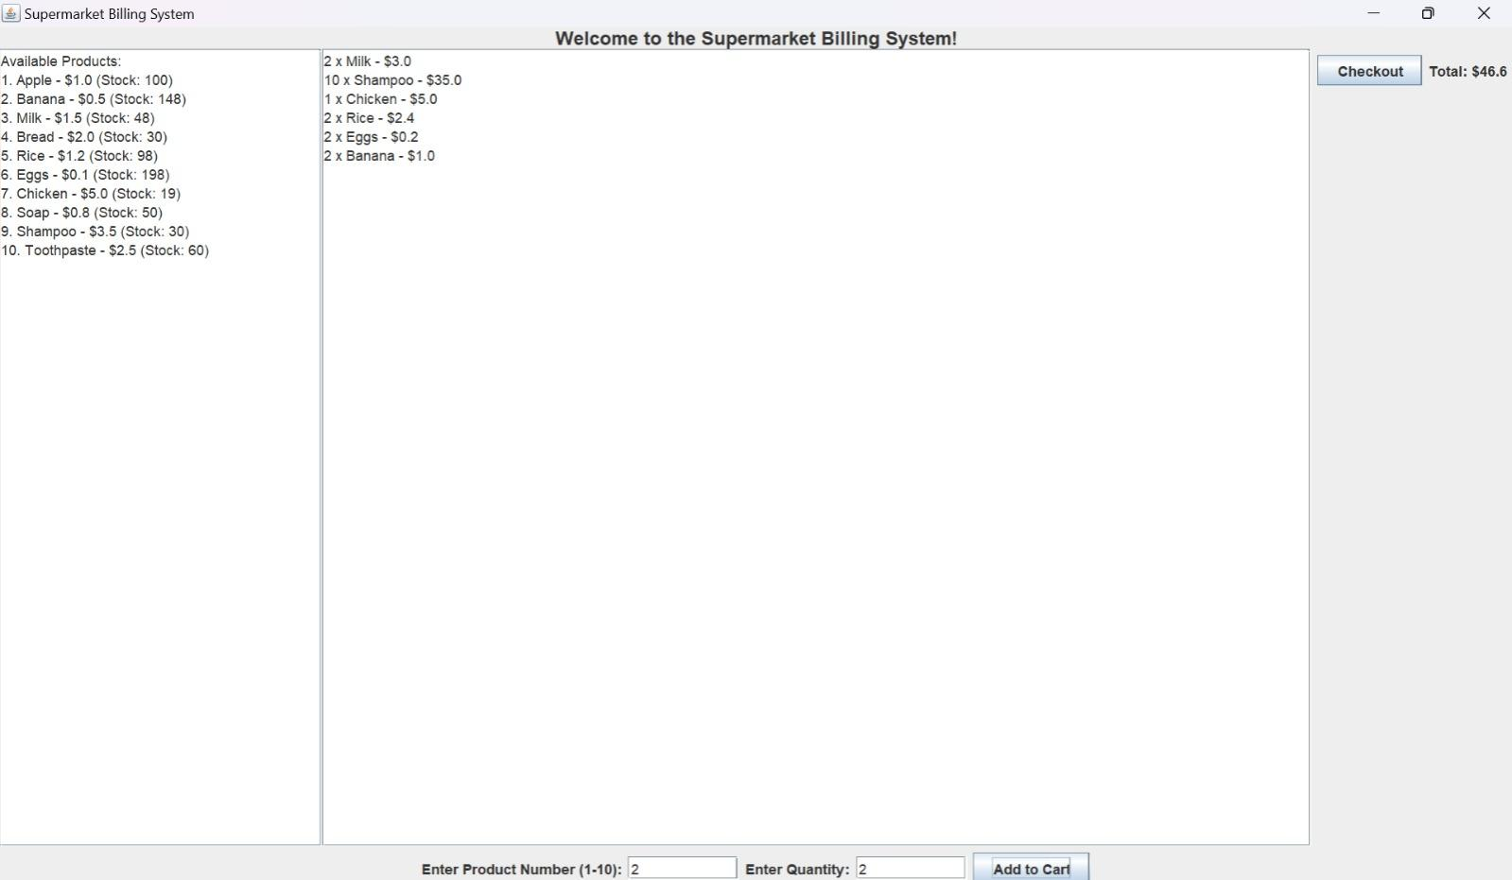
RESULTS AND DISCUSSION

Slide 13
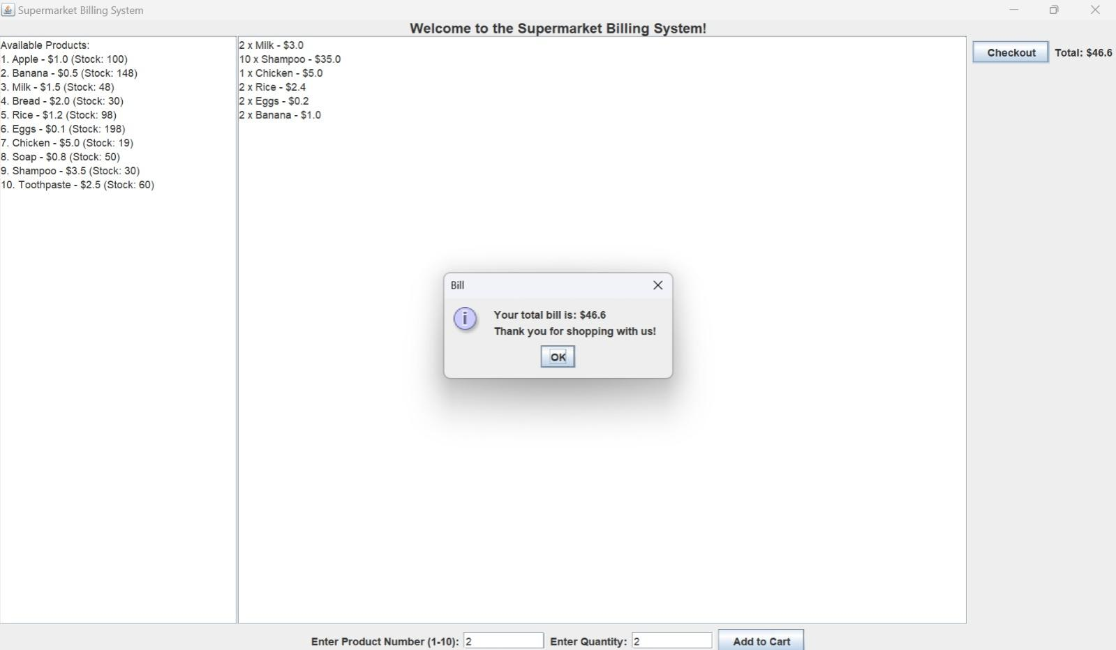
RESULTS AND DISCUSSION

Slide 14
QUERIES ?

